Slide 1
Course 3
Unsupervised learning, recommender systems and reinforcement learning
Welcome!
Notes:
Welcome to Course 3. In this course, we move beyond supervised learning and explore three important areas in machine learning: unsupervised learning, recommender systems, and reinforcement learning.
Until now, we focused mainly on supervised learning, where models learn from labeled data. In this course, we will study new types of learning where the structure is different. In unsupervised learning, the model works with data that has no labels and tries to discover patterns or hidden structure.
In recommender systems, we learn how systems suggest products, movies, or content based on user behavior.
In reinforcement learning, we study how an agent learns to make decisions by interacting with an environment and receiving rewards.
This course will help students understand how modern intelligent systems work in real-world applications such as online shopping, streaming platforms, robotics, and game playing. By the end of this course, students will see how machine learning can go beyond prediction and become a tool for discovering structure, making recommendations, and learning through experience.

Slide 2





Beyond Supervised Learning
Unsupervised Learning
  Clustering
  Anomaly detection
Recommender Systems
Reinforcement Learning
Andrew Ng
Notes:
In this slide, we introduce learning methods that go beyond supervised learning. Until now, we worked with labeled data, where the model learns from correct answers. In this course, we study other important types of learning.
First, we explore unsupervised learning, where the data has no labels and the algorithm must find patterns by itself. This includes clustering, which groups similar data points, and anomaly detection, which identifies unusual examples.
We will also study recommender systems, which suggest products or content based on user behavior, and reinforcement learning, where an agent learns by interacting with an environment and receiving rewards. This slide gives a simple overview of the main topics of Course 3.

Slide 3
Clustering – Content
What is clustering
K-means intution
K-means algorithm
Optimization Algorithm
Initializing K-means
Choosing the number of clusters

Slide 4
Clustering
What is clustering?
Notes:
In this slide, we begin the topic of clustering, which is one of the main techniques in unsupervised learning. Clustering is a method used to group similar data points together when we do not have labeled outputs.
Unlike supervised learning, clustering does not try to predict a specific target value. Instead, it looks at the data and tries to discover natural groupings or patterns. The algorithm analyzes the similarity between data points and places similar ones in the same group, called a cluster.
Clustering helps us understand the structure of data. For example, it can group customers with similar behavior, group similar news articles, or group patients with similar medical characteristics. The main idea of clustering is simple: similar examples should belong to the same group, and different examples should belong to different groups.

Slide 5
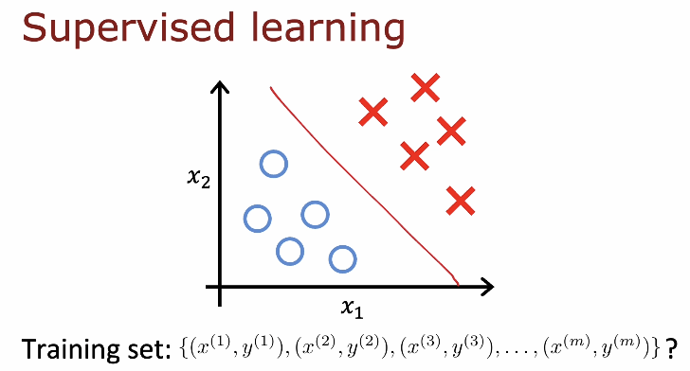
Notes:
This slide reminds us what supervised learning looks like. In supervised learning, each training example includes both the input features and the correct output label. The training set is written as pairs ((x^{(i)}, y^{(i)})), which means that for every input (x), we know the correct answer (y).
In the figure, we see two features, (x_1) and (x_2), and two different classes shown with different symbols. The red line represents the decision boundary that separates the two classes. The model learns this boundary using the labeled training data.
The key idea is that in supervised learning, the algorithm learns from “right answers.” It uses the labeled examples to find a rule or boundary that can correctly classify new data points.
This slide prepares us to compare supervised learning with clustering, where no labels are given.

Slide 6
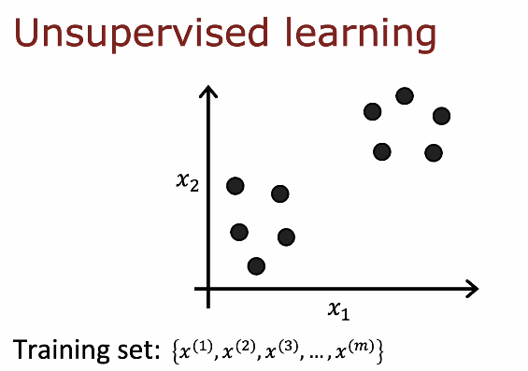
Notes:
This slide shows how unsupervised learning is different from supervised learning. In unsupervised learning, the training set contains only input features, written as (x^(1), x^(2), x^{(3), …, x^(m)). There are no output labels (y). This means the algorithm does not know the correct answers in advance.
In the figure, we see data points plotted using two features, (x_1) and (x_2). Unlike supervised learning, there are no class labels or decision boundaries. However, we can visually notice that the points form natural groups.
The goal of unsupervised learning is to discover this hidden structure automatically. The algorithm tries to identify patterns or clusters in the data without being told what the correct groups are. This is the key idea behind clustering and other unsupervised methods.

Slide 7
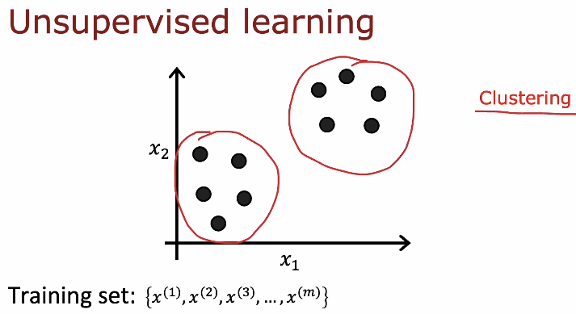
Notes:
In this slide, we see unsupervised learning applied to clustering. The training set contains only inputs written as x^(1), x^(2), x^(3), …, x^(m). There are no output labels y. This means the algorithm must discover patterns in the data by itself.
In clustering, the goal is to divide the data into K groups called clusters. Each example x^(i) is assigned to one of the K clusters. For example, if we have K clusters, each point will belong to cluster 1, cluster 2, up to cluster K.
So clustering automatically groups similar data points together by minimizing distances inside each cluster.

Slide 8
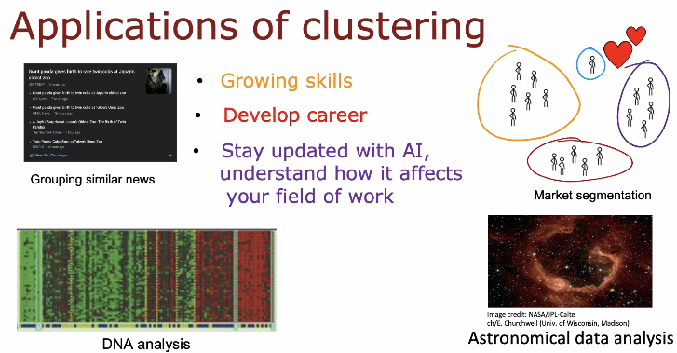
Notes:
This slide shows some important applications of clustering in real life. Clustering is not only a theoretical idea, but it is widely used in many fields.
One application is grouping similar news articles. For example, a news website can automatically group articles that talk about the same event or topic. The algorithm looks at the content of each article and groups similar ones together, even without labeled categories.
Another important application is market segmentation. Companies use clustering to divide customers into groups based on similar behavior, interests, or buying patterns. Each group can then be targeted with different marketing strategies. This helps businesses make better decisions and improve customer satisfaction.
Clustering is also used in DNA analysis. In biology and medicine, scientists group genes or patients based on similar patterns. This can help in understanding diseases, discovering new treatments, or identifying genetic similarities.
In astronomical data analysis, clustering helps scientists group stars, galaxies, or other space objects based on their properties. Since space data is very large and complex, clustering helps researchers find meaningful structure in it.
Overall, clustering helps us discover hidden patterns in data across many domains such as business, healthcare, science, and technology.

Slide 9
Clustering
K-means intuition
Understand the idea behind the algorithm before seeing formulas
Notes:
In this section, we begin to understand the intuition behind the K-means clustering algorithm. K-means is one of the most popular and widely used clustering methods. The main idea is simple: we choose K cluster centers and assign each data point to the nearest center. Then, we update each center to be the average of the points assigned to it.
By repeating these two steps, assignment and update, the algorithm gradually forms clear clusters in the data. This section focuses on building a strong conceptual understanding of how K-means works before going into mathematical details.

Slide 10
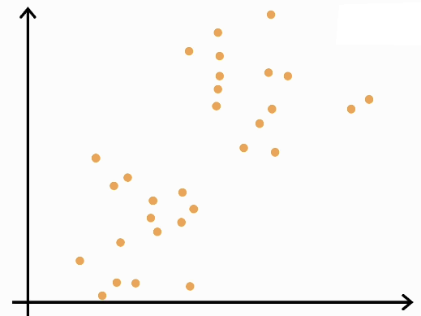
Notes:
In this slide, we see a dataset plotted using two features. The points are not labeled, and we do not know how many groups exist. However, by looking at the figure, we can visually notice that the data seems to form natural clusters.
The goal of K-means is to automatically discover these groups. Even though the data points are mixed together at the beginning, the algorithm will try to separate them into meaningful clusters based on similarity.
This slide helps us build intuition: clustering starts with raw, unlabeled data, and our task is to find structure inside it.

Slide 11
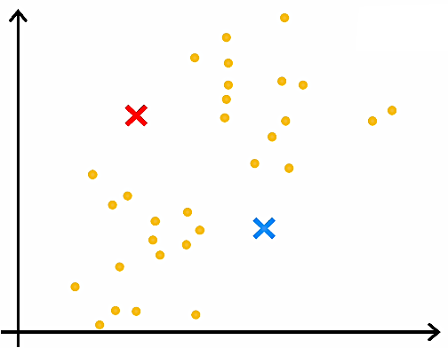
Notes:
In this slide, we see the first step of the K-means algorithm. The colored X marks represent the initial cluster centers, also called centroids. These centers are usually chosen randomly at the beginning.
At this stage, the data points are still unlabeled. We have not yet assigned them to any cluster. The centroids are just starting positions that the algorithm will use to begin grouping the data.
This slide shows that K-means starts with an initial guess for the cluster centers, and then it will improve these positions step by step.

Slide 12
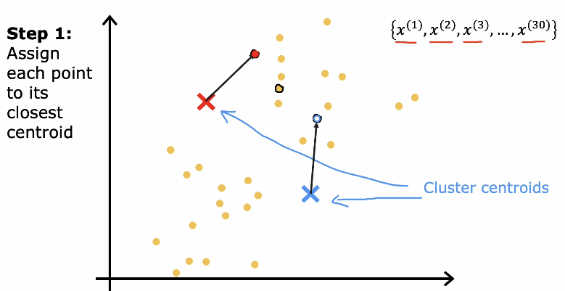
Notes:
In this slide, we see Step 1 of the K-means algorithm. In this step, we assign each data point x^(i) to the nearest centroid. The centroids are shown as colored X marks.
For every example x^(i), we compute its distance to each centroid. The most common distance used is the Euclidean distance. Then we assign x^(i) to the cluster whose centroid is closest.
In simple terms, each point joins the group of the nearest center. After this step, every data point belongs to one of the clusters. This is called the assignment step, and it is the first main step in K-means.

Slide 13
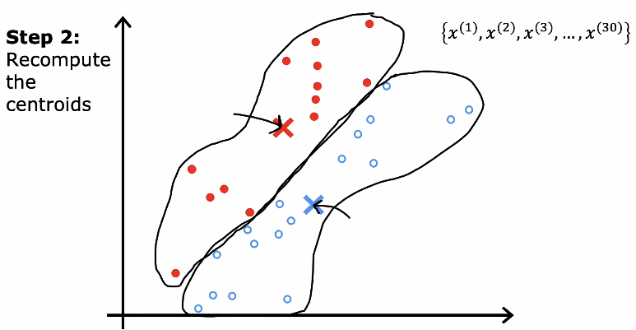
X
X
Notes:
In this slide, we see Step 2 of the K-means algorithm. After assigning each data point x^(i) to its closest centroid, we now recompute the centroids.
For each cluster k, we calculate a new centroid mu^(k). The new centroid is the average of all points assigned to that cluster. In simple English, we add all x^(i) in cluster k and divide by the number of points in that cluster.
This step moves the centroids to the center of their assigned points. After updating the centroids, we repeat Step 1 and Step 2 again.
By repeating assignment and update, the clusters gradually become more accurate and stable.

Slide 14
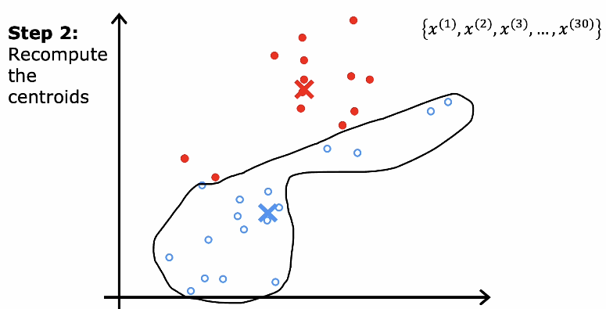
Notes:
This slide shows the updated centroids after recomputing them. Once we calculate the new centroid mu^(k) as the average of all x^(i) assigned to cluster k, the centroid moves to a new position.
Because the centroids have moved, the cluster boundaries may change. Some points may now be closer to a different centroid than before. This means we will go back to Step 1 and reassign each x^(i) to the nearest centroid again.
K-means repeats these two steps — assignment and re-computation — until the centroids stop changing significantly. At that point, the clusters become stable, and the algorithm has converged.

Slide 15
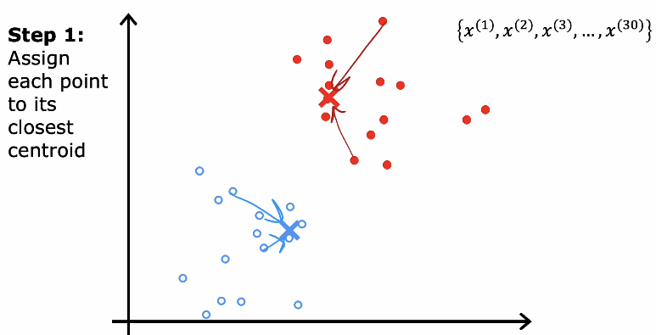
Notes:
This slide shows Step 1 again after the centroids have been updated. Now that the centroids mu^(1) and mu^(2) have moved to new positions, we reassign each data point x^(i) to its nearest centroid.
For every x^(i), we compute its distance to each centroid and choose the closest one. Because the centroids have shifted, some points may change their cluster compared to the previous iteration.
This process of assigning points to the nearest centroid and then recomputing the centroids continues repeatedly. With each iteration, the clusters become more compact and better separated, until the centroids stop moving and the algorithm converges.

Slide 16
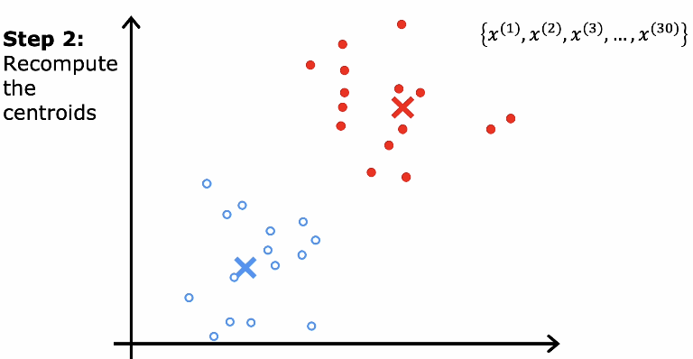
Algorithm converged
Notes:
This slide shows Step 2 again, where we recompute the centroids after reassigning the points. For each cluster k, we calculate the new centroid mu^(k) as the average of all x^(i) that belong to that cluster.
Because the assignments may have changed in the previous step, the centroids move again to better represent their clusters. The red centroid moves to the center of the red points, and the blue centroid moves to the center of the blue points.
K-means keeps repeating Step 1 and Step 2 until the centroids stop moving significantly. At that point, the clusters are stable, and the algorithm has reached convergence.

Slide 17
K-means Summary and Next Step
K-means works using two repeated steps.
Step 1: Assign each point x^(i) to the nearest centroid.
Step 2: Update each centroid to be the mean (average) of the points assigned to it.
Repeat until the centroids stop changing (convergence).
Next, we will formalize K-means mathematically by defining its objective function and writing the algorithm in a precise form.

Slide 18
Clustering
K-means algorithm
formalize K-means mathematically by defining its objective function and writing the algorithm in a precise form.
Notes:
In this section, we move from intuition to the formal K-means algorithm. Previously, we saw visually how points are assigned to the nearest centroid and how centroids are updated. Now, we will describe the algorithm in a clear and structured way.
We will define the steps of K-means more precisely, including how we initialize the centroids, how we assign each x^(i) to a cluster, and how we recompute each centroid mu^(k). We will also introduce the objective function that K-means tries to minimize.
This section focuses on understanding K-means as a complete algorithm that can be implemented step by step.

Slide 19
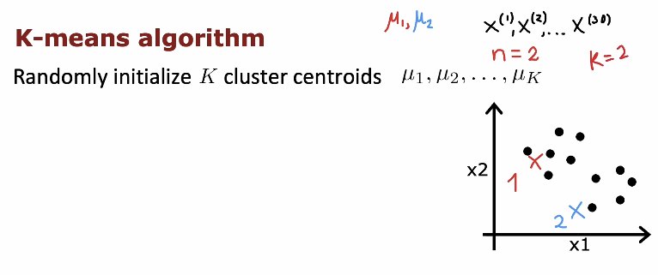
μ1, μ2 are vectors of the same dimension as x^{(i)}
n = 2 : number of features x1 and x2
Notes:
This slide introduces the first step of the formal K-means algorithm. We begin by randomly initializing K cluster centroids, called mu^(1), mu^(2), …, mu^(K). The number K is chosen in advance and represents how many clusters we want to form.
For example, if K = 2, we randomly select two initial centroids. These centroids are just starting points and do not necessarily represent the true centers of the clusters. The dataset consists of examples x^(1), x^(2), …, x^(m), where each example may have n features.
Random initialization is important because the starting positions of the centroids can affect the final result. After initialization, the algorithm will continue with the assignment and update steps to improve the cluster positions.

Slide 20
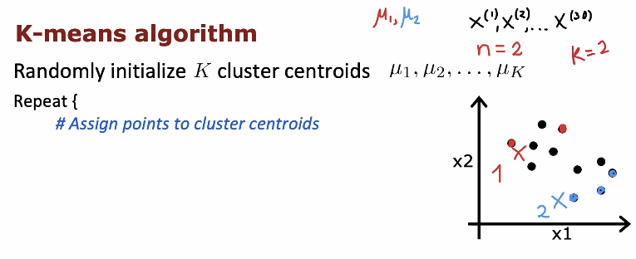
Notes:
This slide continues the K-means algorithm after random initialization of the centroids mu^(1), mu^(2), …, mu^(K).
After choosing the initial centroids, we enter a loop where we repeat two main steps. The first step inside the loop is to assign each data point x^(i) to the nearest centroid. For every example x^(i), we compute its distance to each centroid mu^(k) and assign it to the cluster with the smallest distance.
This assignment step creates temporary clusters based on the current positions of the centroids. After this, we will move to the next step, which is updating the centroids based on the assigned points.

Slide 21
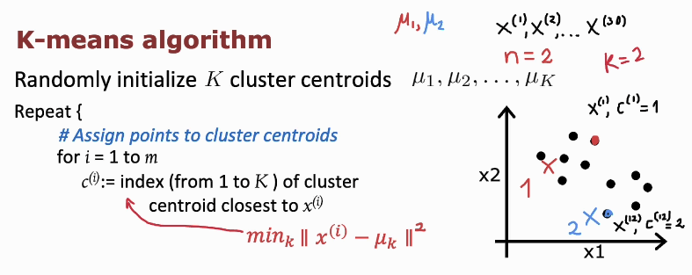
Find k that minimizes the distance
And then k will set to the index c^{(i)}
Notes:
This slide shows the assignment step written more formally.
After initializing the centroids mu^(1), mu^(2), …, mu^(K), we repeat the following process. For each example x^(i), where i goes from 1 to m, we determine which cluster it belongs to.
We define c^(i) as the index of the cluster assigned to x^(i). In simple terms, c^(i) is the number k between 1 and K such that the centroid mu^(k) is closest to x^(i).
Mathematically, we choose c^(i) to minimize the squared distance between x^(i) and mu^(k). In simple English, we compute the distance between x^(i) and each centroid mu^(k), square it, and select the cluster with the smallest value.
This step assigns every data point to its nearest centroid, forming temporary clusters based on the current centroid positions.

Slide 22
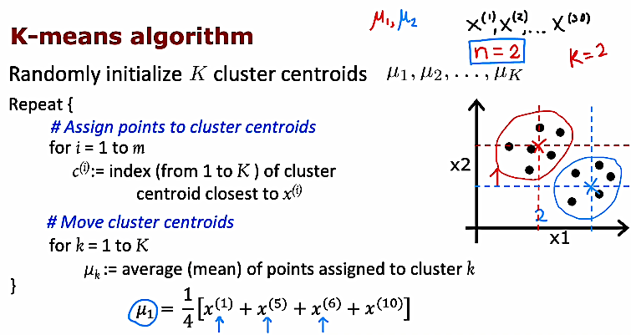
Notes:
This slide shows the complete K-means algorithm.
First, we randomly initialize K cluster centroids mu^(1), mu^(2), …, mu^(K). Then we repeat two main steps until convergence.
Step 1: Assign points to cluster centroids.
For each example x^(i), where i goes from 1 to m, we compute its distance to each centroid. We define c^(i) as the index of the cluster whose centroid is closest to x^(i). In simple words, each point joins the nearest cluster.
Step 2: Move cluster centroids.
For each cluster k from 1 to K, we update the centroid mu^(k). The new mu^(k) equals the average (mean) of all points assigned to cluster k. For example, if four points x^(1), x^(5), x^(6), and x^(10) belong to cluster 1, then mu^(1) equals one divided by four times the sum of these four points.
These two steps — assignment and update — are repeated until the centroids stop changing significantly. At that point, the clusters become stable and the algorithm converges.

Slide 23
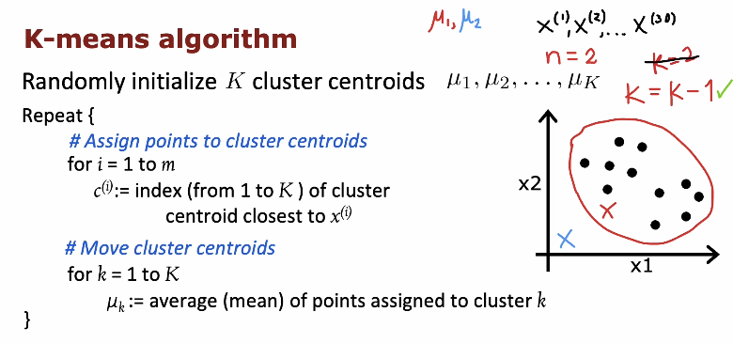
What happened if
a centroid has 0 points
Assigned to it.
Eliminate that cluster
Notes:
This slide highlights an important point about choosing the number of clusters K.
The K-means algorithm starts by randomly initializing K centroids mu^(1), mu^(2), …, mu^(K). Then it repeats the assignment and update steps. However, the quality of the clustering depends strongly on the value of K.
If K is chosen too large, we may create too many small clusters. If K is chosen too small, we may group very different points into the same cluster. In the figure, we see an example where changing the value of K changes the clustering result.
Choosing the correct value of K is an important practical problem in clustering. In the next topic, we will discuss methods for selecting a good value for K, such as the elbow method.
It also depends on the random positions of the clusters centroids, so that if a centroid position is made a way from the points then it might not capture and of the points.

Slide 24
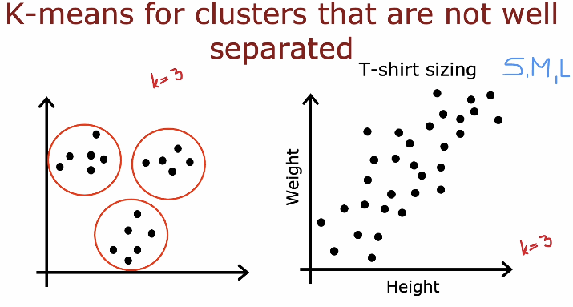
Notes:
This slide explains an important limitation of K-means clustering.
On the left side, we see a case where the clusters are clearly separated. When K = 3, K-means works well because the groups are compact and far from each other. The algorithm can easily assign points to the correct cluster.
On the right side, we see a different situation using height and weight data for T-shirt sizing (S, M, L). The data points form a continuous pattern rather than clearly separated groups. Even if we choose K = 3, the clusters may not be very distinct. K-means will still divide the data into three groups, but the separation may not perfectly match real categories like small, medium, and large.
This slide teaches an important concept: K-means works best when clusters are compact and well separated. When the data forms overlapping or continuous patterns, the results may not be ideal. Therefore, before applying K-means, we should examine whether the data naturally forms distinct groups.

Slide 25
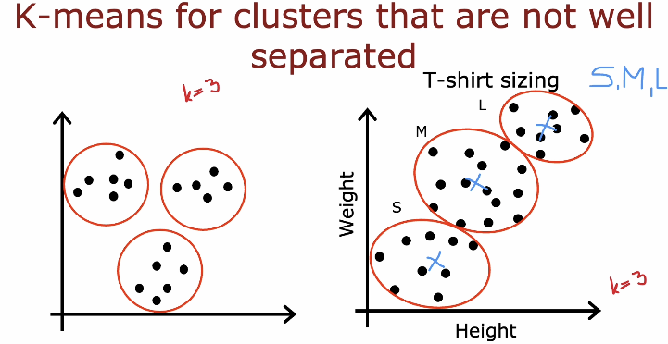
Notes:
This slide continues the discussion about clusters that are not well separated.
On the left side, when K = 3 and the groups are clearly separated, K-means works very well. Each cluster is compact, and the centroids are located near the center of each group.
On the right side, we see a more realistic example using height and weight for T-shirt sizing (S, M, L). The data forms a gradual, continuous pattern rather than clearly separated groups. Even though we set K = 3, the boundaries between small, medium, and large are not very clear. K-means will still divide the data into three clusters, but the separation may overlap and may not perfectly match real-world categories.
The key lesson is that K-means assumes clusters are roughly circular and well separated. When data is continuous or overlapping, K-means can still produce clusters, but the results may not perfectly represent meaningful categories. Therefore, understanding the data structure is very important before applying K-means.

Slide 26
K-means starts by randomly initializing the cluster centroids, then repeatedly assigns each point to the nearest centroid and updates the centroids.
A key question is: what is this algorithm really doing behind the scenes, and will it always converge or could it run forever?
To better understand why k-means converges, we need to see that it is actually minimizing a specific cost function.
Next topic:
K-means Optimization Objective – understanding the cost function that k-means is trying to minimize.

Slide 27
Clustering
Optimization objective
What is the K-means Optimization Objective –understanding the cost function that k-means is trying to minimize.
Notes:
In this section, we move from the procedural steps of K-means to understanding its optimization objective. Until now, we described how the algorithm works: assign points to the nearest centroid and then recompute the centroids. Now we ask a deeper question: what exactly is K-means trying to minimize?
K-means is an optimization algorithm. Its goal is to minimize the total squared distance between each data point x^(i) and the centroid of the cluster it is assigned to. In simple English, it tries to make points inside each cluster as close as possible to their cluster center.
Understanding this objective helps students see that K-means is not just a heuristic process. It is systematically reducing a specific cost function at every iteration. In the next slides, we will define this objective function clearly and see how each step of the algorithm reduces it.

Slide 28
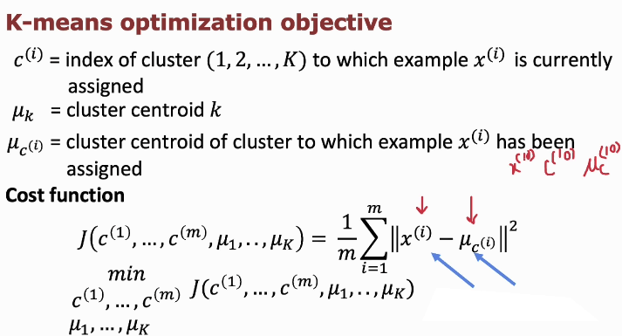
Distance between data point (i)
and the cluster centroid to which
it belongs
Notes:
This slide explains the optimization objective of K-means more formally.
First, c^(i) represents the index of the cluster to which example x^(i) is currently assigned. The value of c^(i) can be any number from 1 to K.
If K = 3 and:
x^(1) belongs to cluster 2 → c^(1) = 2
x^(2) belongs to cluster 1 → c^(2) = 1
x^(3) belongs to cluster 3 → c^(3) = 3
So: c^(i) tells us which centroid that point belongs to.
Second, mu^(k) represents the centroid of cluster k.
Third, mu^(c^(i)) represents the centroid of the cluster that x^(i) belongs to.
The cost function of K-means is written as:
J = (1 divided by m) times the sum from i = 1 to m of the squared distance between x^(i) and mu^(c^(i)).
In simple English, this means we compute the squared distance between each data point x^(i) and the centroid of its assigned cluster. Then we add all these squared distances together and divide by m, the number of training examples.
The goal of K-means is to choose the cluster assignments c^(1), …, c^(m) and the centroids mu^(1), …, mu^(K) in a way that minimizes this cost function J.
This shows that K-means is trying to make each cluster as compact as possible by reducing the total distance between points and their cluster centers.

Slide 29
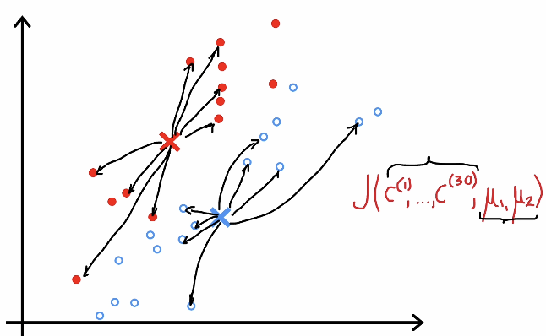
The goal of K-means is to adjust the cluster assignments c^(1), …, c^(m) and the centroids mu^(1), mu^(m), … so that these arrows become as short as possible
Update assignment
Update location of mu
Notes:
This slide gives a visual understanding of the K-means cost function.
Each arrow represents the distance between a data point x^(i) and the centroid of the cluster it belongs to, mu^(c^(i)). The cost function J is based on these distances. Specifically, J equals the average of the squared distances between each point and its assigned centroid.
In simple English, the longer the arrows, the larger the cost. If points are far from their centroids, the value of J becomes large. If points are close to their centroids, the value of J becomes small.
The goal of K-means is to adjust the cluster assignments c^(1), …, c^(m) and the centroids mu^(1), mu^(2), … so that these arrows become as short as possible. In other words, the algorithm tries to minimize J by making clusters compact and tight around their centers.

Slide 30
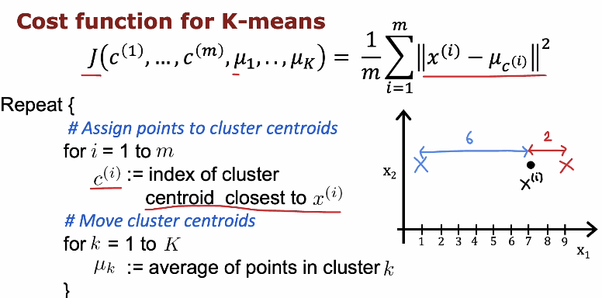
Keep mu
fixed
Keep points
fixed
Notes:
This slide connects the cost function with the two steps of the K-means algorithm.
The cost function J equals one divided by m times the sum from i equals 1 to m of the squared distance between x^(i) and mu^(c^(i)). In simple English, we measure how far each point is from the centroid of the cluster it belongs to, square that distance, and average over all points.
The assignment step reduces the cost by assigning each x^(i) to the nearest centroid. This ensures that for the current centroids, we choose the cluster that gives the smallest possible distance.
The update step reduces the cost further by moving each centroid mu^(k) to the average of the points in its cluster. This new position minimizes the total squared distance for that cluster.
By repeating these two steps, the value of J keeps decreasing or staying the same at each iteration. Eventually, the algorithm reaches a point where J no longer decreases significantly, and the clustering becomes stable.
In the figure, we have:
One data point x^(i) (the black dot).
Two centroids (the red X and the blue X).
The distances from the point to each centroid are shown:
Distance to the blue centroid = 6
Distance to the red centroid = 2
What is happening here?
K-means assigns each point to the nearest centroid.
Since 2 < 6, the point x^(i) will be assigned to the red centroid.

Slide 31
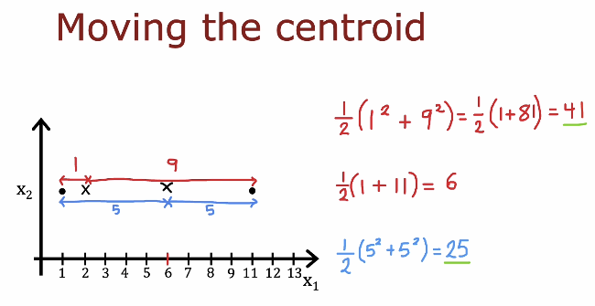
Move the centroid to average
the 2 points to find the new location
Notes:
This slide explains why the centroid should be placed at the mean of the points in a cluster.
Suppose we have two points on a line. If we place the centroid somewhere between them, the total squared distance depends on its position. The cost we want to minimize is the average of the squared distances between each point and the centroid.
For example, if the centroid is placed closer to one point and far from the other, one squared distance becomes large. When we compute one divided by two times the sum of the squared distances, the result is large. However, when we place the centroid exactly at the middle, which is the average of the two points, the squared distances become balanced and the total cost becomes smaller.
Case 1 (Red centroid on the left)
Distances are:
1 unit to the first point
9 units to the second point
Cost = (1/2) * (1^2 + 9^2) = = (1/2) * (1 + 81) = = 41
Case 3 (Blue centroid at the middle)
Distances are:
5 units
5 units
Cost = (1/2) * (5^2 + 5^2)= = (1/2) * (25 + 25) = = 25
This is the smallest cost.
This slide shows that choosing the centroid as the mean of the assigned points minimizes the squared error. That is why in K-means, after assigning points to a cluster, we update the centroid by taking the average of those points.

Slide 32
Sum-up
K-means has converged when the cost function J stops decreasing or decreases very slowly.
Monitoring the cost function helps us decide when to stop the algorithm.
Running K-means multiple times with different random initializations and choosing the lowest cost often gives better clusters.
Next, we will study how to choose the number of clusters K and how to improve the practical performance of K-means.

Slide 33
Clustering
Initializing K-means
How do we actually take the random guess i.e
The initial locations of the cluster centriod
Notes:
In this section, we focus on how to initialize K-means properly. Initialization means choosing the initial centroids mu^(1), mu^(2), …, mu^(K) before starting the assignment and update steps.
The starting positions of the centroids are very important because K-means can converge to different solutions depending on the initial choice. Poor initialization may lead to bad clustering results or higher cost values.
In the next slides, we will see practical strategies for initializing centroids and how better initialization can improve the final clustering outcome.

Slide 34
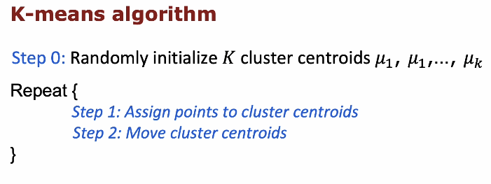
Notes:
This slide summarizes the full K-means algorithm in a simple structured way.
Step 0: Randomly initialize K cluster centroids mu^(1), mu^(2), …, mu^(K). These are the starting positions of the cluster centers.
Then repeat the following two steps:
Step 1: Assign each data point x^(i) to the nearest centroid.
Step 2: Move each centroid mu^(k) to the average of the points assigned to it.
These steps are repeated until the centroids stop changing significantly. The quality of the final clusters depends strongly on how we initialize the centroids in Step 0, which is why initialization is an important topic.

Slide 35
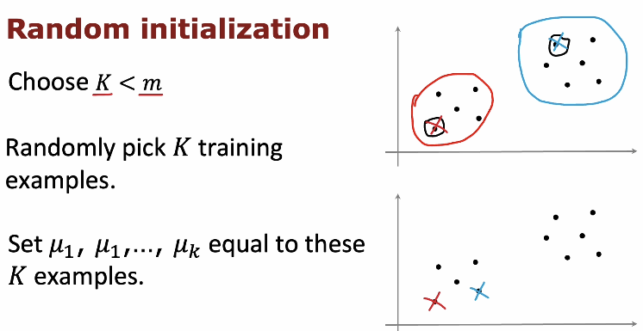
One possibility is to
make this choice
Other possibility is to
make this choice
Notes:
Let’s explain random initialization step by step, referring directly to the diagrams.
First, we choose K such that K < m, where m is the number of training examples. This means the number of clusters must be smaller than the number of data points.
Next, we randomly pick K training examples from the dataset. In the top-right diagram, you see two natural groups of points (one red cluster on the left and one blue cluster on the right). However, during random initialization, we do not yet know these true clusters. We simply pick K points at random from all available points.
In the bottom-right diagram, you see two X marks (one red and one blue). These represent the randomly selected training examples. We then set the initial centroids mu_1 and mu_2 equal to these selected examples.
Notice something important: the selected centroids might not be at the center of the true clusters. They may even both start near one side or in suboptimal positions. That is normal. K-means will later move these centroids during the update steps.
So random initialization means:
Randomly choose K data points.
Use their coordinates as the initial centroids.
Then start the iterative process of assignment and updating.
The algorithm relies on repeated updates to move these initially random centroids toward better positions.

Slide 36
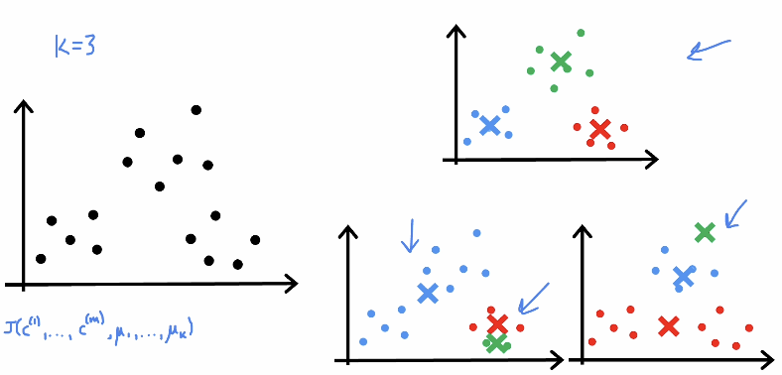

Good choice
bad choice
bad choice
Local min.
Notes:
This slide illustrates why random initialization can lead to different results when K = 3.
We start with the same dataset, but because the initial centroids are chosen randomly, each run of K-means may begin with different starting points. As the algorithm repeats the assignment and update steps, the centroids move and the clusters are formed.
In some cases, the algorithm finds a good clustering where each group is compact and well separated. In other cases, poor initial centroids may lead to less optimal clusters with higher cost J.
This slide shows that K-means can converge to different local minima depending on initialization. That is why it is recommended to run K-means multiple times with different random initializations and choose the clustering with the lowest cost.

Slide 37
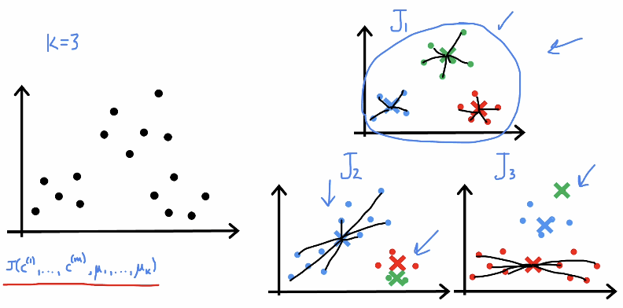
Distance between points
and centroids (cost J) is the smallest
Among then all
Notes:
This slide explains an important idea about K-means: different initializations can lead to different final costs.
Here we set K = 3 and run K-means multiple times with different random initial centroids. Even though we use the same dataset, each run may produce different clustering results. These results are labeled as J1, J2, and J3, which represent different final values of the cost function J.
Remember that the cost function J equals one divided by m times the sum of the squared distances between each point x^(i) and its assigned centroid mu^(c^(i)). The smaller the value of J, the better the clustering, because it means the points are closer to their cluster centers.
In some runs, the centroids are initialized in good positions, and the algorithm converges to a solution with small cost (for example J1). In other runs, poor initialization may cause the algorithm to converge to a worse local minimum, giving a larger cost (for example J2 or J3).
This slide teaches a very important practical lesson: K-means does not always find the global minimum. It may converge to a local minimum depending on the initial centroids. Therefore, in practice, we run K-means multiple times with different random initializations and choose the solution that gives the smallest cost J.
This approach increases the chance of finding a better and more meaningful clustering result.

Slide 38
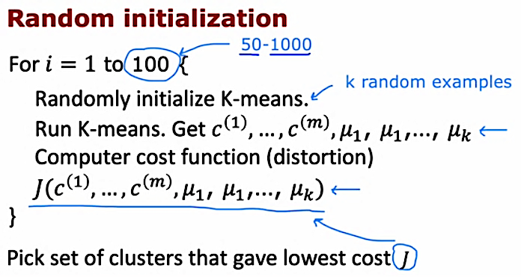
100 times initializations
Notes:
This slide explains the recommended practical strategy for random initialization in K-means.
Instead of running K-means only once, we repeat the algorithm many times. For example, we may run it from i = 1 to 100, or even between 50 and 1000 times, depending on the problem size.
In each run, we randomly initialize the K centroids using K random training examples. Then we run the full K-means algorithm until convergence. After it finishes, we compute the cost function J, which measures the distortion or total squared distance between points and their assigned centroids.
At the end of all runs, we compare the cost values from each run and select the clustering that produced the lowest cost J. This solution is considered the best among the different random initializations.
This method significantly improves the chance of finding a better clustering solution and reduces the risk of getting stuck in a poor local minimum.

Slide 39
Sum-up
In practice, we usually run K-means multiple times with different random initializations because this helps minimize the distortion cost function and find better cluster centroids.
Using more than one initialization increases the chance of getting a better clustering result.
Next, we will discuss how to choose the number of clusters K and how to decide the best value for K in practice.

Slide 40
Clustering
Choosing the Number of Clusters
How many clusters do we choose?
Notes:
In this section, we address an important practical question in clustering: how do we choose the number of clusters K?
The value of K must be selected before running K-means, but in many real-world problems, the correct number of clusters is not known in advance. Choosing K too small may combine different groups into one cluster, while choosing K too large may split natural groups into smaller, unnecessary clusters.
In the next slides, we will discuss practical methods for selecting a good value of K, including techniques such as analyzing the cost function and using the elbow method.

Slide 41
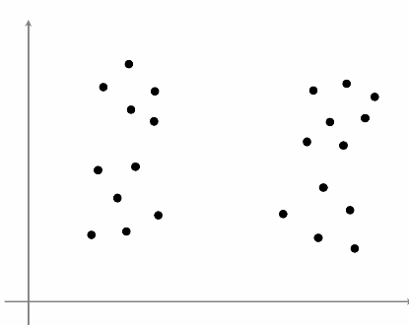
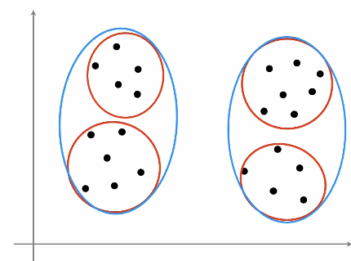
What is the right value of K
Notes:
This slide highlights the difficulty of choosing the correct value of K.
In the figure, we see data that could reasonably be grouped in different ways. If we choose K = 2, we might create two larger clusters that contain smaller subgroups inside them. If we choose K = 4, we might separate those smaller subgroups into individual clusters.
Both choices may seem reasonable depending on the context. There is no single “correct” value of K in all situations. The right choice depends on the structure of the data and on the goal of the analysis.
This slide emphasizes that selecting K is not always obvious and requires careful evaluation using systematic methods, which we will study next.

Slide 42
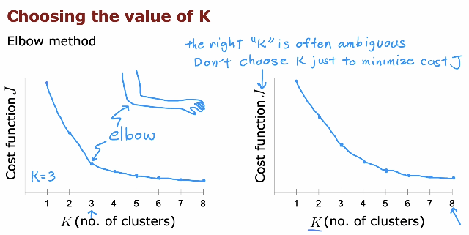
Notes:
This slide explains the Elbow Method for choosing the value of K.
We plot the cost function J on the vertical axis and the number of clusters K on the horizontal axis. As K increases, the cost J always decreases because adding more clusters reduces the distance between points and their centroids.
However, we do not choose K simply by minimizing J, because J will keep decreasing as K increases. Instead, we look for a point where the decrease in cost becomes much slower. This point looks like an “elbow” in the curve.
The idea is that before the elbow, increasing K gives a large improvement in reducing cost. After the elbow, increasing K gives only small improvement. Therefore, the value of K at the elbow is often a good choice.
However, as shown in the second graph, sometimes the elbow is not very clear. In such cases, choosing K can be ambiguous, and we may need additional judgment or domain knowledge.

Slide 43
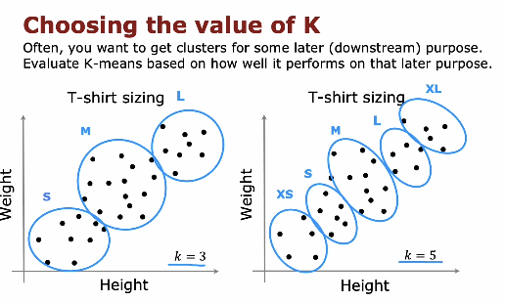
Notes:
This slide explains that choosing K often depends on the final goal of clustering.
Sometimes clustering is not the final objective. Instead, it is used for a later task, called a downstream purpose. For example, in T-shirt sizing based on height and weight, the goal may be to define size categories such as S, M, and L.
If we choose K = 3, we may obtain three clusters that correspond roughly to small, medium, and large sizes. However, if the business requires more detailed sizing such as XS, S, M, L, and XL, then choosing K = 5 may be more appropriate.
This slide shows that the “best” value of K is not always determined only by minimizing the cost function. Instead, it should also consider how useful the clusters are for the final application. Domain knowledge and practical needs play an important role in selecting K.

Slide 44
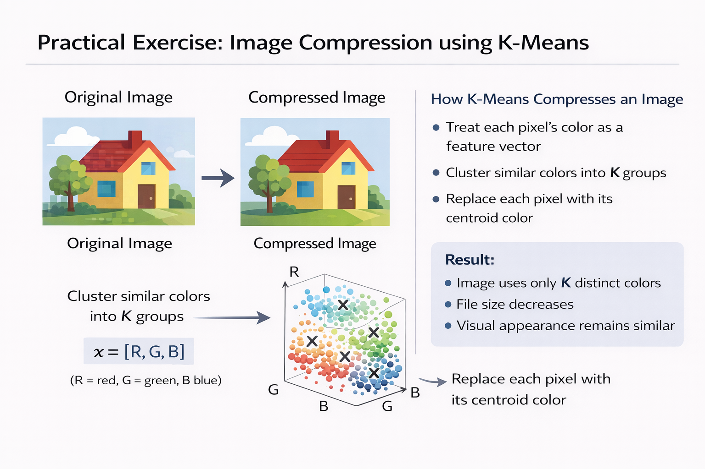
Notes:
This slide introduces a practical exercise: image compression using K-means clustering.
In this lab, we apply clustering to images. Each pixel in an image has color values, usually represented by three numbers (for example, red, green, and blue). These color values can be treated as features of a data point.
The idea is to use K-means to reduce the number of colors in the image. Instead of using many different colors, we group similar colors into K clusters. Then, each pixel is replaced by the color of its cluster centroid.
As a result, the image uses fewer distinct colors, which reduces storage size while keeping the overall appearance similar. This exercise helps students see how clustering can be used in a real-world application such as image compression.

Slide 45
SUM-UP
We have completed the K-means clustering algorithm, which is our first unsupervised learning method.
Now you understand both supervised learning and unsupervised learning.
K-means is widely used and very practical, especially in applications like image compression.
Next, we move to our second unsupervised learning algorithm: Anomaly Detection.
In anomaly detection, the goal is different from clustering. Instead of grouping similar points, we try to detect unusual or abnormal data points in a dataset. This is very important in real-world applications such as fraud detection, network security, medical diagnosis, and system monitoring.

Slide 46
Anomaly Detection
Finding unusual events
Notes:
In this section, we introduce anomaly detection, which is another important unsupervised learning method.
Unlike clustering, where we group similar data points, anomaly detection focuses on finding unusual or rare events in a dataset. These unusual examples are called anomalies or outliers. They are data points that look very different from the majority of the data.
The goal of anomaly detection is to build a model of what “normal” data looks like. Then, when a new example appears, we check whether it is similar to normal data or very different. If it is very unlikely under the model, we classify it as an anomaly.
This method is widely used in fraud detection, network security, fault detection in machines, and medical diagnosis. In the next slides, we will see how to model normal data and mathematically decide whether an example is unusual.

Slide 47
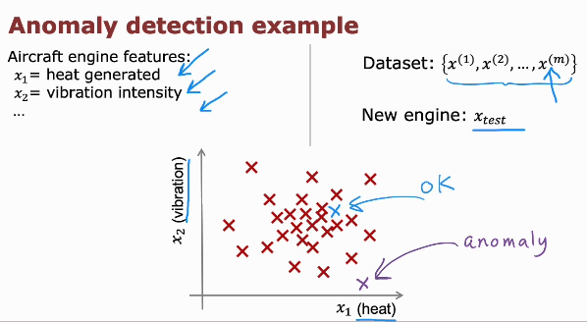
Notes:
This slide shows a practical example of anomaly detection using aircraft engine data.
Suppose we collect features from aircraft engines, such as x1 equals heat generated and x2 equals vibration intensity. We build a dataset consisting of normal engines, written as x^(1), x^(2), …, x^(m). These examples represent engines that are operating correctly.
We use this dataset to learn what “normal” behavior looks like. Most of the normal engines will form a dense region in the feature space, as shown in the figure.
Now suppose we receive a new engine measurement called x_test. We compare x_test to the learned model of normal behavior. If x_test falls inside the normal region, we classify it as OK. If it is far away from the normal cluster, we classify it as an anomaly.
This is the key idea of anomaly detection: model normal data, and flag new examples that are very different from normal behavior.

Slide 48
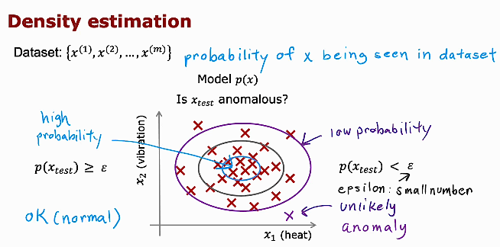
Notes:
This slide explains the main idea behind anomaly detection using density estimation.
We start with a dataset x^(1), x^(2), …, x^(m) that represents normal examples. From this data, we build a model p(x), which estimates the probability of seeing a data point x. In simple terms, p(x) tells us how likely a point is under the normal behavior of the system.
When a new example x_test arrives, we compute p(x_test). If p(x_test) is large, this means the example is likely and similar to the normal data. In this case, we classify it as normal.
If p(x_test) is very small, this means the example is unlikely under the model. We compare it to a small threshold called epsilon. If p(x_test) is less than epsilon, we declare it an anomaly.
So the decision rule is simple:
If p(x_test) is greater than or equal to epsilon, the example is normal.
If p(x_test) is less than epsilon, the example is an anomaly.
This approach models normal data and flags any very low-probability example as unusual.

Slide 49
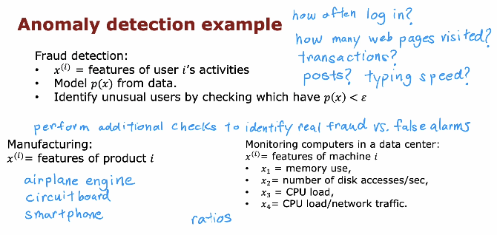
Notes:
This slide gives several real-world applications of anomaly detection.
In fraud detection, each example x^(i) represents features of a user’s activities, such as how often they log in, how many web pages they visit, how many transactions they make, or their typing speed. We build a model p(x) from normal user behavior. If a user has p(x) less than epsilon, we flag the activity as unusual. After that, additional checks are often performed to distinguish real fraud from false alarms.
In manufacturing, x^(i) may represent features of a product, such as measurements from an airplane engine, a circuit board, or a smartphone. If the product’s features are very unlikely under the normal model, it may indicate a defect.
In monitoring computers in a data center, x^(i) can represent machine features such as memory usage, number of disk accesses per second, CPU load, or network traffic. If these values behave abnormally compared to normal operation, the system can detect possible failures or attacks.
These examples show that anomaly detection is widely used in finance, industry, and technology to identify rare but important abnormal events.

Slide 50
Sum-up
Anomaly detection is a very useful tool for identifying unusual or rare events in data.
To build an anomaly detection model, we need to model the probability distribution p(x) of the data.
A common approach is to use the Gaussian (normal) distribution to model normal behavior.
Next, we will study the Gaussian distribution and understand how it is used to model p(x) in anomaly detection.

Slide 51
Anomaly Detection
Gaussian (Normal) Distribution
Notes:
In this section, we introduce the Gaussian (Normal) distribution, which is a key tool for anomaly detection.
To detect anomalies, we need to model the probability p(x) of normal data. The Gaussian distribution is commonly used for this purpose because many real-world measurements follow a bell-shaped pattern around a mean value.
The Gaussian distribution is defined by two main parameters: the mean, which represents the average value, and the variance, which measures how spread out the data is around the mean.
In the next slides, we will learn the formula of the Gaussian distribution and see how to estimate its parameters from data in order to compute p(x) for anomaly detection.

Slide 52
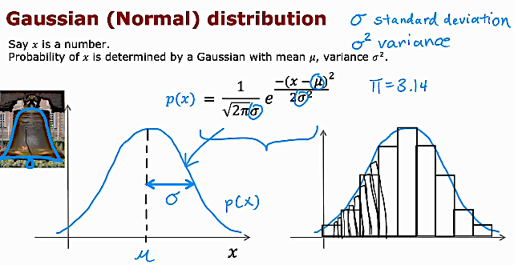
Notes:
This slide introduces the Gaussian, also called the Normal distribution.
Suppose x is a real number. We assume that x follows a Gaussian distribution defined by two parameters: mu and sigma squared. Mu is the mean, which represents the average value of the data. Sigma squared is the variance, which measures how spread out the data is around the mean. The square root of the variance is called sigma, which is the standard deviation.
The probability density function is written as:
p(x) equals one divided by the square root of 2 times pi times sigma squared, multiplied by e raised to the power of minus (x minus mu) squared divided by 2 times sigma squared.
In simple terms, this formula gives the probability density of x. The curve has a bell shape centered at mu. Most values are concentrated near the mean, and the probability decreases as we move farther away from mu.
The parameter sigma controls the width of the curve. If sigma is small, the curve is narrow and tall. If sigma is large, the curve is wider and flatter.
This Gaussian model will be used to estimate p(x) in anomaly detection, so that we can determine whether a new example is likely or unlikely.

Slide 53
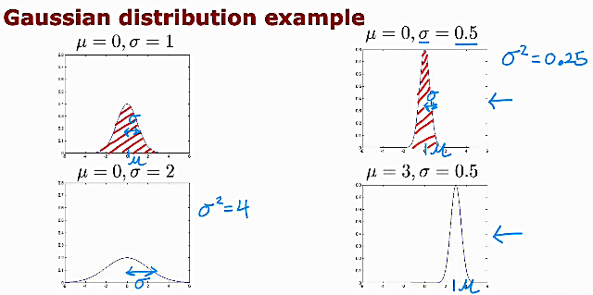
Notes:
This slide shows how changing the parameters mu and sigma affects the shape of the Gaussian distribution.
In the first example, mu equals 0 and sigma equals 1. The curve is centered at 0 and has a standard spread.
In the second example, mu equals 0 and sigma equals 2. Since sigma is larger, the curve becomes wider and flatter. The variance sigma squared equals 4 in this case. This means the data is more spread out around the mean.
In the third example, mu equals 0 and sigma equals 0.5. Here sigma squared equals 0.25, so the curve becomes narrower and taller. This means the data is more concentrated around the mean.
In the last example, mu equals 3 and sigma equals 0.5. The shape is narrow like before, but the entire curve is shifted to the right because the mean has changed from 0 to 3.
This slide helps students understand that mu controls the center of the distribution, while sigma controls how wide or narrow the distribution is.

Slide 54
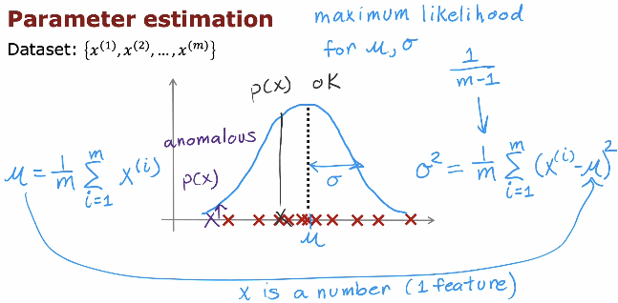
Notes:
This slide explains how we estimate the parameters of the Gaussian distribution from data.
Suppose we have a dataset x^(1), x^(2), …, x^(m), where each x is a number (one feature). We want to estimate the parameters mu and sigma squared that best describe the data.
The mean mu is calculated as:
mu equals one divided by m times the sum from i equals 1 to m of x^(i).
In simple words, mu is the average of all training examples.
The variance sigma squared is calculated as:
sigma squared equals one divided by m times the sum from i equals 1 to m of (x^(i) minus mu) squared.
This measures how far the data points are spread around the mean.
These formulas come from maximum likelihood estimation, which chooses the parameters mu and sigma squared that make the observed data most likely under the Gaussian model.
Once we estimate mu and sigma squared from normal data, we can compute p(x) for any new example and decide whether it is normal or anomalous.

Slide 55
Sum-up
So far, we modeled anomaly detection using one feature only, where x is a single number and we used a single Gaussian distribution.
In real applications, we usually have multiple features, so x becomes a vector, and we need a model that can handle many variables together.
Next topic:
We will extend the Gaussian model to handle multiple features and build a more practical anomaly detection algorithm.

Slide 56
Anomaly Detection
Algorithm
Notes:
In this section, we will bring everything together and present the full anomaly detection algorithm. After learning about Gaussian distributions and parameter estimation, we are now ready to see how to combine these ideas into a practical method that can detect unusual or abnormal examples in a dataset.

Slide 57
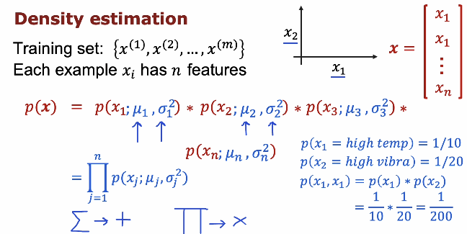
Notes:
In anomaly detection, each example x usually has multiple features, not just one. So instead of x being a single number, we write it as a vector:
x = [x1, x2, ..., xn]
For example, in an aircraft engine, x1 could represent heat generated, x2 could represent vibration intensity, and other features could describe additional measurements. The training set contains m examples, written as {x^(1), x^(2), ..., x^(m)}, and each example has n features.
To decide whether a new example is normal or anomalous, we need to compute its probability p(x). The main idea in density estimation is to model each feature separately using its own Gaussian distribution. For each feature xj, we estimate a mean mu_j and a variance sigma_j^2 from the training data. Then we compute the probability of that feature using the Gaussian formula.
To compute the probability of the whole example x, we assume that the features are independent. This means the joint probability can be written as a product of individual probabilities:
p(x) = p(x1; mu1, sigma1^2) * p(x2; mu2, sigma2^2) * ... * p(xn; mun, sigman^2)
In short, p(x) is the product from j = 1 to n of p(xj; mu_j, sigma_j^2). We multiply the probabilities, not add them.
For example, if the probability of high temperature is 1/10 and the probability of high vibration is 1/20, then the combined probability is 1/10 times 1/20, which equals 1/200. When several unusual features occur together, the overall probability becomes very small.
This is the key idea behind multi-feature anomaly detection: if p(x) is large, the example is likely normal. If p(x) is very small (less than a threshold epsilon), we classify it as an anomaly.

Slide 58
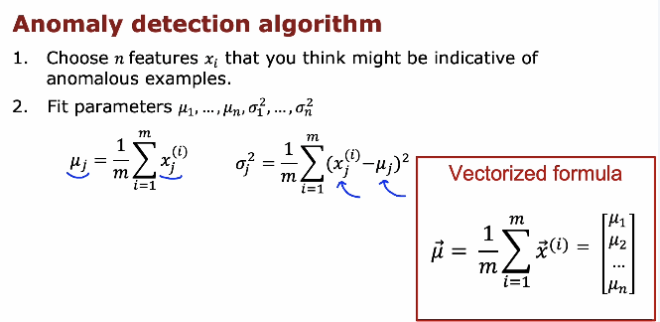
Notes:
In the anomaly detection algorithm, the first step is to choose the n features that you believe may help detect unusual or abnormal examples. These features should describe normal behavior clearly. For example, in a machine system, features might include temperature, vibration, memory usage, or CPU load. The quality of anomaly detection strongly depends on choosing meaningful features.
After selecting the features, we estimate the parameters of the Gaussian distribution for each feature. For every feature xj, we compute the mean mu_j and the variance sigma_j^2 using the training data. The mean is calculated as mu_j = (1/m) times the sum from i = 1 to m of x_j^(i). The variance is calculated as sigma_j^2 = (1/m) times the sum from i = 1 to m of (x_j^(i) − mu_j)^2. These parameters describe what “normal” values look like for each feature.
In vectorized form, we can compute all the means together. The mean vector mu is equal to (1/m) times the sum from i = 1 to m of x^(i), where mu becomes a column vector containing mu_1, mu_2, ..., mu_n. This makes implementation more efficient and clean in practice.

Slide 59
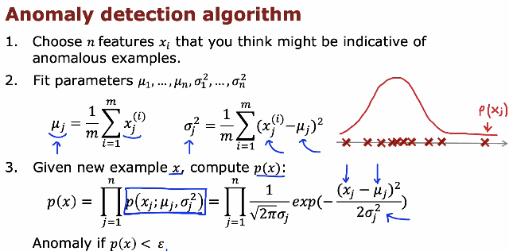
Notes:
This slide summarizes the complete anomaly detection algorithm.
First, we choose n features x1, x2, ..., xn that may help us identify anomalous examples. These features should describe normal behavior clearly and make unusual behavior stand out.
Second, we estimate the parameters of the Gaussian distribution for each feature using the training set {x^(1), ..., x^(m)}. For each feature xj, we compute the mean mu_j as (1/m) times the sum from i = 1 to m of x_j^(i). We also compute the variance sigma_j^2 as (1/m) times the sum from i = 1 to m of (x_j^(i) − mu_j)^2. These values describe the normal distribution of each feature.
Third, given a new example x, we compute its probability p(x). Since we assume features are independent, we calculate p(x) as the product from j = 1 to n of p(xj; mu_j, sigma_j^2). Each term p(xj; mu_j, sigma_j^2) is computed using the Gaussian formula:
p(xj) = 1 / (sqrt(2π) sigma_j) times exp( − (xj − mu_j)^2 / (2 sigma_j^2) )
Finally, we compare p(x) with a small threshold epsilon.
If p(x) is less than epsilon, we classify the example as an anomaly. Otherwise, we consider it normal.

Slide 60
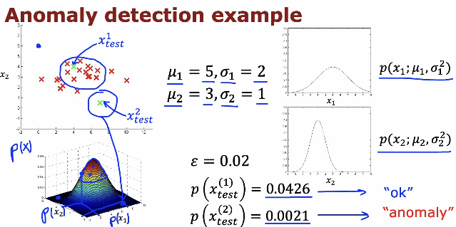
Notes:
This slide shows a complete example of anomaly detection using two features, x1 and x2.
From the training data, we estimate the Gaussian parameters for each feature. For example, we have mu1 = 5 and sigma1 = 2 for feature x1, and mu2 = 3 and sigma2 = 1 for feature x2. These values describe what “normal” data looks like along each dimension.
For a new test example x_test, we compute its probability p(x). Since we assume independence, we compute p(x) as p(x1) multiplied by p(x2). Each of these probabilities is obtained from its corresponding Gaussian distribution.
We then compare the final probability p(x_test) with a threshold epsilon. In this example, epsilon = 0.02. For the first test example, p(x_test^(1)) = 0.0426, which is greater than 0.02, so it is classified as normal (“OK”). For the second test example, p(x_test^(2)) = 0.0021, which is less than 0.02, so it is classified as an anomaly.
The 3D plot illustrates how p(x) forms a surface over the feature space. Points near the center of the distribution have high probability, while points far from the center have low probability and are more likely to be detected as anomalies.

Slide 61
Sum-up
We have learned how to build an anomaly detection system and compute p(x), but we still need to decide how to choose the threshold epsilon.
We also need a way to evaluate whether the system is working well and detecting anomalies correctly.
Next topic:
How to select epsilon and evaluate the performance of an anomaly detection system using proper evaluation methods.

Slide 62




Anomaly Detection
Developing and evaluating an anomaly detection system
Practical tips to develop anomaly detection system
Notes:
In this section, we will focus on how to properly develop and evaluate an anomaly detection system. Building the model is only part of the work. We also need to choose the threshold epsilon carefully and measure how well the system detects anomalies. We will learn how to split the data, tune the parameters, and evaluate performance to make sure the system works reliably in real applications.

Slide 63
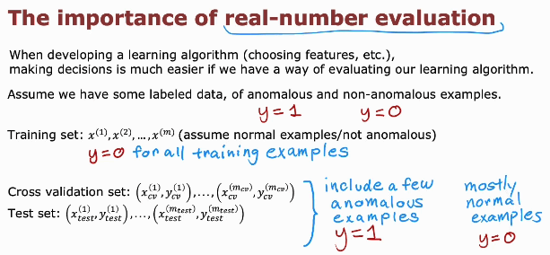
Notes:
This slide explains why real-number evaluation is important when building an anomaly detection system.
When developing a learning algorithm, such as choosing features or selecting epsilon, we need a clear way to measure performance. Without evaluation, we cannot know whether the system is improving or not.
In anomaly detection, we usually train the model using mostly normal examples. So in the training set, we typically assume y = 0 for all examples, meaning they are normal. We use this data to estimate the Gaussian parameters.
However, for evaluation, we need labeled data that includes both normal examples (y = 0) and some anomalous examples (y = 1). Therefore, we create a cross-validation set and a test set that contain mostly normal examples but also a few anomalies.
The cross-validation set is used to choose parameters such as epsilon. The test set is used to evaluate the final performance of the system. This setup allows us to make objective, quantitative decisions about how well the anomaly detection system is working.
In anomaly detection, the model evaluates each example with a real number (probability). That’s why we call it real-number evaluation. The classification happens only after we apply the threshold.

Slide 64
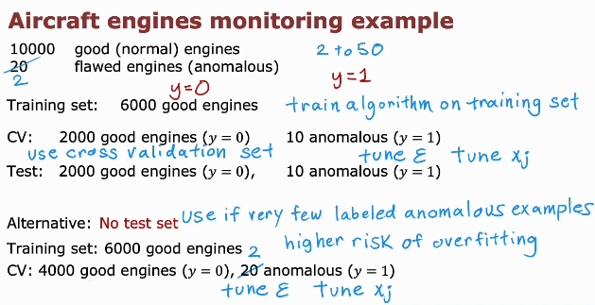
Notes:
This slide gives a practical example of how to split data when building an anomaly detection system, using aircraft engine monitoring.
Suppose we have 10,000 engines. Most of them are good (normal), and only a small number are flawed (anomalous). In anomaly detection, normal examples are labeled y = 0, and anomalous examples are labeled y = 1. Usually, the number of anomalies is very small compared to normal examples.
We first create a training set that contains only normal engines, for example 6,000 good engines. We use this training set to fit the Gaussian parameters of the model. The model learns what “normal” engines look like.
Next, we create a cross-validation (CV) set that includes mostly normal engines, for example 2,000 good engines, and a small number of anomalous engines, such as 10 flawed ones. We use this set to tune epsilon and possibly improve the choice of features. This helps us choose the threshold that best separates normal from anomalous engines.
Finally, we use a test set, which again contains mostly normal engines and a few anomalous ones, to evaluate the final performance of the system. This gives us an unbiased estimate of how well the model works.
An alternative approach, when there are very few labeled anomalous examples, is to skip the separate test set and use a larger cross-validation set. However, this increases the risk of overfitting, because we use the same data for tuning and evaluation.

Slide 65
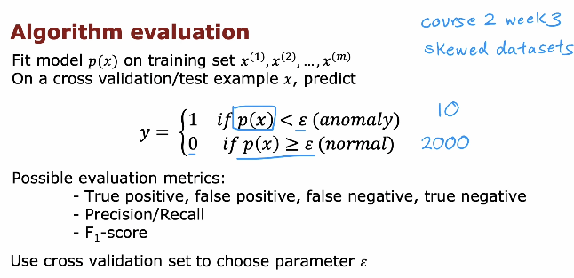
Notes:
This slide explains how to evaluate an anomaly detection algorithm.
First, we train the model p(x) using the training set, which contains mostly normal examples. we train the model by calculating the average and spread of each feature using normal data. And we do that for all features using all data points.
After learning the parameters (average and variance), we use the cross-validation or test set to make predictions. For each example x, we compute p(x). If p(x) is less than or equal to epsilon, we predict y = 1, meaning anomaly. If p(x) is greater than epsilon, we predict y = 0, meaning normal.
Since anomaly detection problems usually have very skewed datasets (many normal examples and very few anomalies), accuracy alone is not a good metric. Instead, we use evaluation metrics such as true positive, false positive, false negative, and true negative. From these, we compute precision and recall, and often the F1-score, which balances both.
We use the cross-validation set to choose the best value of epsilon. The goal is to select the threshold that gives good detection of anomalies while keeping false alarms low.

Slide 66
SUM-UP
Use the cross-validation set to measure how many anomalies are correctly detected and how many normal examples are incorrectly flagged. This helps you choose a good value of epsilon.
When you have at least a small number of labeled anomalous examples, evaluation becomes easier and more practical.
Link to next topic:
This raises an important question: if we already have labeled examples of anomalies, should we continue using anomaly detection (unsupervised learning), or should we switch to a supervised learning algorithm instead?
In the next section, we will compare anomaly detection and supervised learning, and discuss when to prefer one over the other.

Slide 67
Anomaly Detection
Anomaly detection vs. supervised learning
Notes:
In this section, we will compare anomaly detection with supervised learning. Although both can be used to identify unusual or abnormal examples, they are designed for different situations.
We will discuss the differences between them and understand when anomaly detection is more appropriate, and when supervised learning is the better choice.

Slide 68
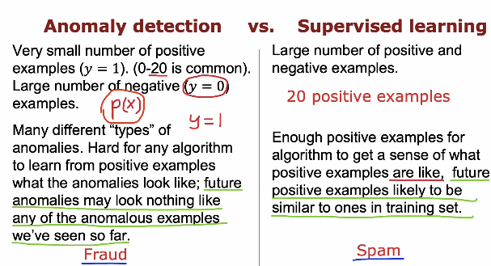
Notes:
This slide compares anomaly detection and supervised learning and explains when to use each approach.
In anomaly detection, we usually have a very small number of positive examples (y = 1), sometimes only 0 to 20. We mostly have negative examples (y = 0), which represent normal behavior.
In addition, anomalies can be very different from each other. Future anomalies may look completely different from the few anomalous examples we have seen before. Because of this, it is difficult to learn a reliable decision boundary from the positive examples alone. Instead, anomaly detection focuses on modeling normal behavior p(x) and flags anything very unlikely as an anomaly. A typical example is fraud detection, where new fraud patterns may appear that are different from past cases.
In supervised learning, we usually have a larger number of both positive and negative examples. There are enough positive examples for the algorithm to learn what they look like. Also, future positive examples are likely to be similar to the ones seen during training. In this case, a supervised classifier can learn to distinguish between the two classes directly. A common example is spam detection, where spam emails often follow similar patterns over time.
The key difference is this: anomaly detection is preferred when anomalies are rare and diverse, while supervised learning is preferred when we have enough labeled examples of both classes and future examples are expected to look similar to the training data.

Slide 69
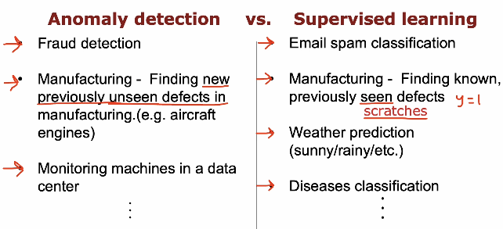
Notes:
This slide gives practical examples to clarify the difference between anomaly detection and supervised learning.
Anomaly detection is used when we want to detect rare or previously unseen problems. Examples include fraud detection, where new fraud patterns may appear that were not seen before. In manufacturing, it is used to detect new or previously unseen defects, such as unexpected failures in aircraft engines. It is also used for monitoring machines in data centers, where we want to detect unusual system behavior that may indicate a new type of failure.
Supervised learning, on the other hand, is used when we want to classify known categories that we have already seen in the training data. For example, email spam classification works because we have many labeled examples of spam and non-spam emails. In manufacturing, supervised learning can be used to detect known defects, such as specific types of scratches. Other examples include weather prediction (sunny, rainy, etc.) and disease classification, where the classes are predefined and well represented in the training data.
The key idea is that anomaly detection focuses on identifying unusual or new patterns, while supervised learning focuses on distinguishing between known and well-defined classes.

Slide 70
Sum-up
Anomaly detection is used when positive examples are rare and future anomalies may look very different from past ones. Supervised learning is used when we have enough labeled positive examples and future cases are similar to training data.
In anomaly detection, the choice of features is very important, because the algorithm learns what is “normal” based on these features.
Link to next topic:
Since features play a critical role in anomaly detection, the next section will focus on practical tips for selecting and tuning features to improve the performance of the anomaly detection system.

Slide 71
Anomaly Detection
Choosing what features to use
Notes:
In this section, we focus on one of the most important parts of building an anomaly detection system: choosing the right features. The performance of the algorithm depends heavily on the features we select, because the model learns what is “normal” based on them.
We will discuss how to design meaningful features that help the system clearly distinguish between normal and anomalous behavior.

Slide 72
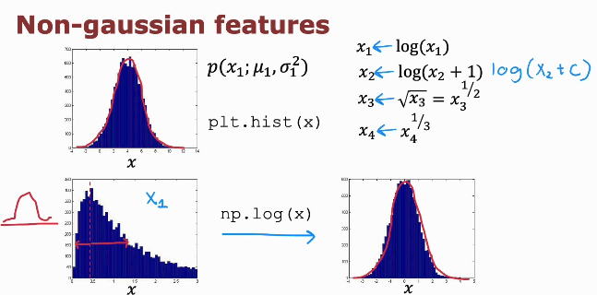
Notes:
This slide explains an important practical issue in anomaly detection: sometimes features are not Gaussian.
Our anomaly detection algorithm assumes that each feature follows a Gaussian (normal) distribution. However, in practice, some features may be highly skewed. For example, a feature like transaction amount, response time, or number of clicks may have many small values and a few very large values. This produces a distribution that is not symmetric and does not look like a bell curve.
If we directly apply a Gaussian model to such a skewed feature, the model will not fit the data well. As a result, p(x) will not be accurate, and anomaly detection performance may suffer.
To fix this, we can transform the feature to make it more Gaussian-like. Common transformations include:
Taking the logarithm: x becomes log(x)
Using log(x + c) if x can be zero
Taking the square root: x becomes sqrt(x)
Taking the cube root: x becomes x^(1/3)
After applying such a transformation, the histogram of the feature often becomes more symmetric and closer to a normal distribution. Then the Gaussian model will fit better.
The key idea is: before fitting the anomaly detection model, always check the distribution of each feature (for example using a histogram). If it is highly skewed, apply a transformation to make it closer to Gaussian. This simple step can significantly improve performance.

Slide 73
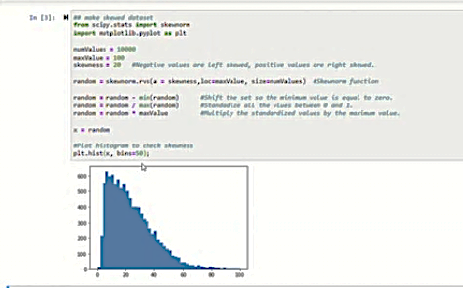
Notes:
This slide shows an example of generating a skewed (non-Gaussian) dataset and visualizing it using a histogram.
In the code, we generate random values using a skewed distribution. The parameter “skewness” controls whether the data is left-skewed or right-skewed. In this case, the data is right-skewed, meaning most values are small, and a few values are very large. After generating the data, we normalize or scale it and then plot a histogram using plt.hist().
The histogram clearly shows that the distribution is not symmetric and does not look like a bell-shaped Gaussian curve. Instead, it has a long tail on one side. This is exactly the type of feature that does not fit well with a Gaussian model.
The purpose of this example is to show how we can detect non-Gaussian features by visualizing them. Once we identify a skewed feature, we can apply a transformation such as log(x) to make the distribution more symmetric and better suited for anomaly detection using a Gaussian model.

Slide 74
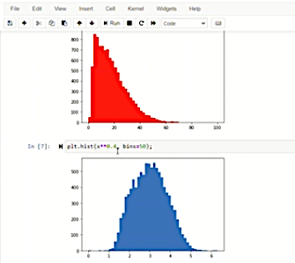
Notes:
This slide shows the effect of applying a transformation to a non-Gaussian feature.
The first histogram (in red) shows a highly skewed distribution. Most values are small, and there is a long tail toward larger values. This type of distribution does not match the Gaussian assumption used in anomaly detection, so modeling it directly with a normal distribution would not be accurate.
After applying a transformation, such as taking the logarithm of the data, we get the second histogram (in blue). Now the distribution looks much more symmetric and bell-shaped. It is closer to a Gaussian distribution.
This example demonstrates why feature transformation is important in anomaly detection. If a feature is skewed, applying transformations like log(x), log(x + c), square root, or cube root can make the data more Gaussian-like. This improves the quality of the probability estimation p(x) and leads to better anomaly detection performance.

Slide 75

Notes:
This slide shows a practical example of applying a logarithmic transformation to a skewed feature.
In the first histogram (red), the data is clearly right-skewed. Most values are small, and there is a long tail toward larger values. This type of distribution does not fit well with the Gaussian assumption used in anomaly detection.
In the code, we apply a transformation using:
np.log(x + 1)
We add 1 before taking the logarithm to avoid problems when x = 0. After applying this transformation, we plot the histogram again. The second histogram (blue) now looks much more symmetric and closer to a bell-shaped Gaussian distribution.
This demonstrates an important practical lesson: before applying the anomaly detection algorithm, we should visualize each feature using a histogram. If a feature is highly skewed, applying a transformation such as log(x + c) can make it more Gaussian-like and improve the accuracy of probability estimation and anomaly detection.

Slide 76

Notes:
This slide discusses error analysis in anomaly detection.
Our goal is clear: we want p(x) to be large for normal examples and small for anomalous examples. In other words, normal data should have probability greater than or equal to epsilon, and anomalies should have probability less than epsilon.
However, a common problem occurs when p(x) is similar for both normal and anomalous examples. In this case, p(x) may be large for both, making it difficult to distinguish anomalies from normal data. This usually means that the chosen features are not good enough to separate the two cases.
For example, if we only use one feature such as number of transactions, an anomalous example might still fall inside the normal range. But if we combine multiple features, such as number of transactions and typing speed, we may better separate normal behavior from anomalies in a two-dimensional space.
The key idea of error analysis is this: when the model fails to detect anomalies correctly, we should examine the features. Often, the solution is not just tuning epsilon, but designing better or additional features that make anomalies clearly different from normal examples.

Slide 77

Notes:
This slide explains how to design good features for anomaly detection using a data center monitoring example.
When monitoring computers in a data center, we should choose features that might take unusually large or unusually small values when something abnormal happens. Examples of basic features include memory usage, number of disk accesses per second, CPU load, and network traffic.
However, sometimes a single feature alone may not clearly indicate an anomaly. For example, high CPU load by itself may not be unusual if network traffic is also high. So instead of using only basic features, we can create new features that capture relationships between them. For example, we can use a ratio such as CPU load divided by network traffic, or even (CPU load)^2 divided by network traffic. These engineered features may highlight abnormal behavior more clearly.
To decide whether a feature is useful, we look at p(x). A good feature should produce large p(x) values for normal examples and small p(x) values for anomalies in the cross-validation set.
The key idea is that feature engineering is critical in anomaly detection. Often, creating meaningful combinations of existing features can significantly improve performance.

